Slide 1
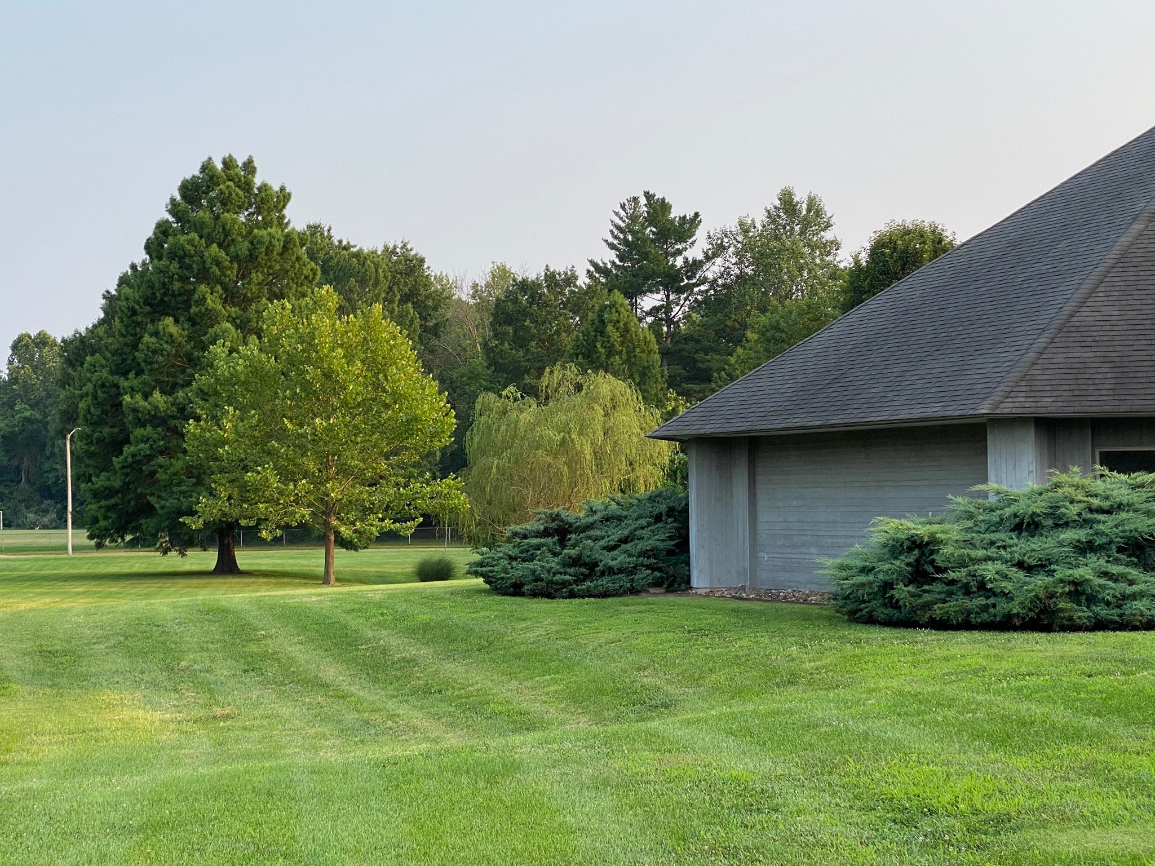
From Lawn to Prairie
Carbondale Unitarian Fellowship

Slide 2
Herbicide in December of 2020 Planting in February of 2021

Slide 3
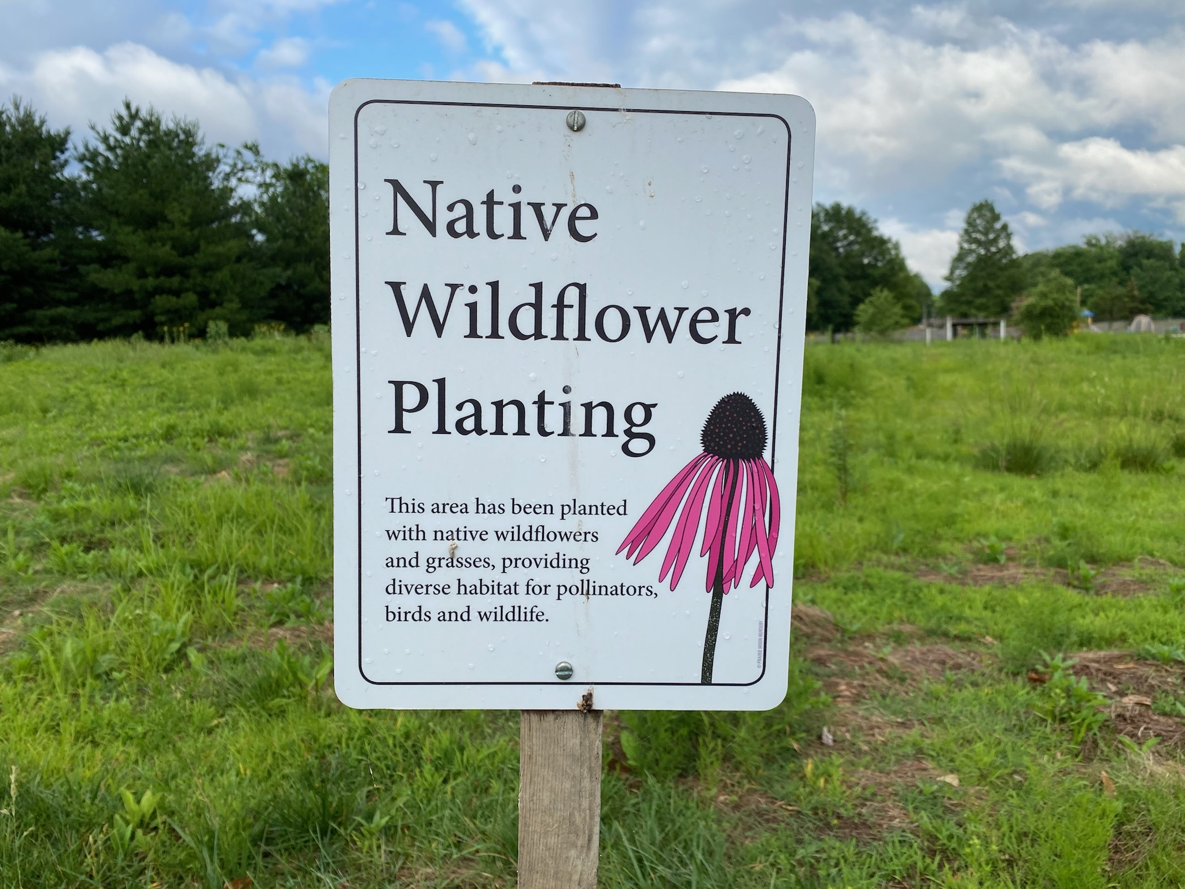
Planted 1 acre in seed donated by Rob Rothrock
Foxglove beardtongue Pale Indian plantain
Rattlesnake master Yellow crown beard
Purple meadow rue Culver’s root
Showy goldenrod Prairie blazing star
False aster White wild Indigo
Blue false Indigo Maryland senna
Sneezeweed Sweet coneflower
Prairie dock Stiff goldenrod
Narrowleaf mtn mint Swamp coneflower
Additional plantings annually

Slide 4
Planted Zinnias for border to our budding prairie in 2021

Slide 5
Our blooming prairie in 2022

Slide 6
May 2023

Slide 7
May 2023

Slide 8
June 2023

Slide 9
June 2023

Slide 10
June 2023

Slide 11
Keep Carbondale Beautiful— Bright Spot Award in July 2023

Slide 12
July 2023

Slide 13
July 2023

Slide 14
August 2023

Slide 15
August 2023

Slide 16
August 2023

Slide 17
September 2023

Slide 18
September 2023

Slide 19
September 2023

Slide 20
September 2023

Slide 21
October 2023

Slide 22
October 2023

Slide 23
October 2023

Slide 24
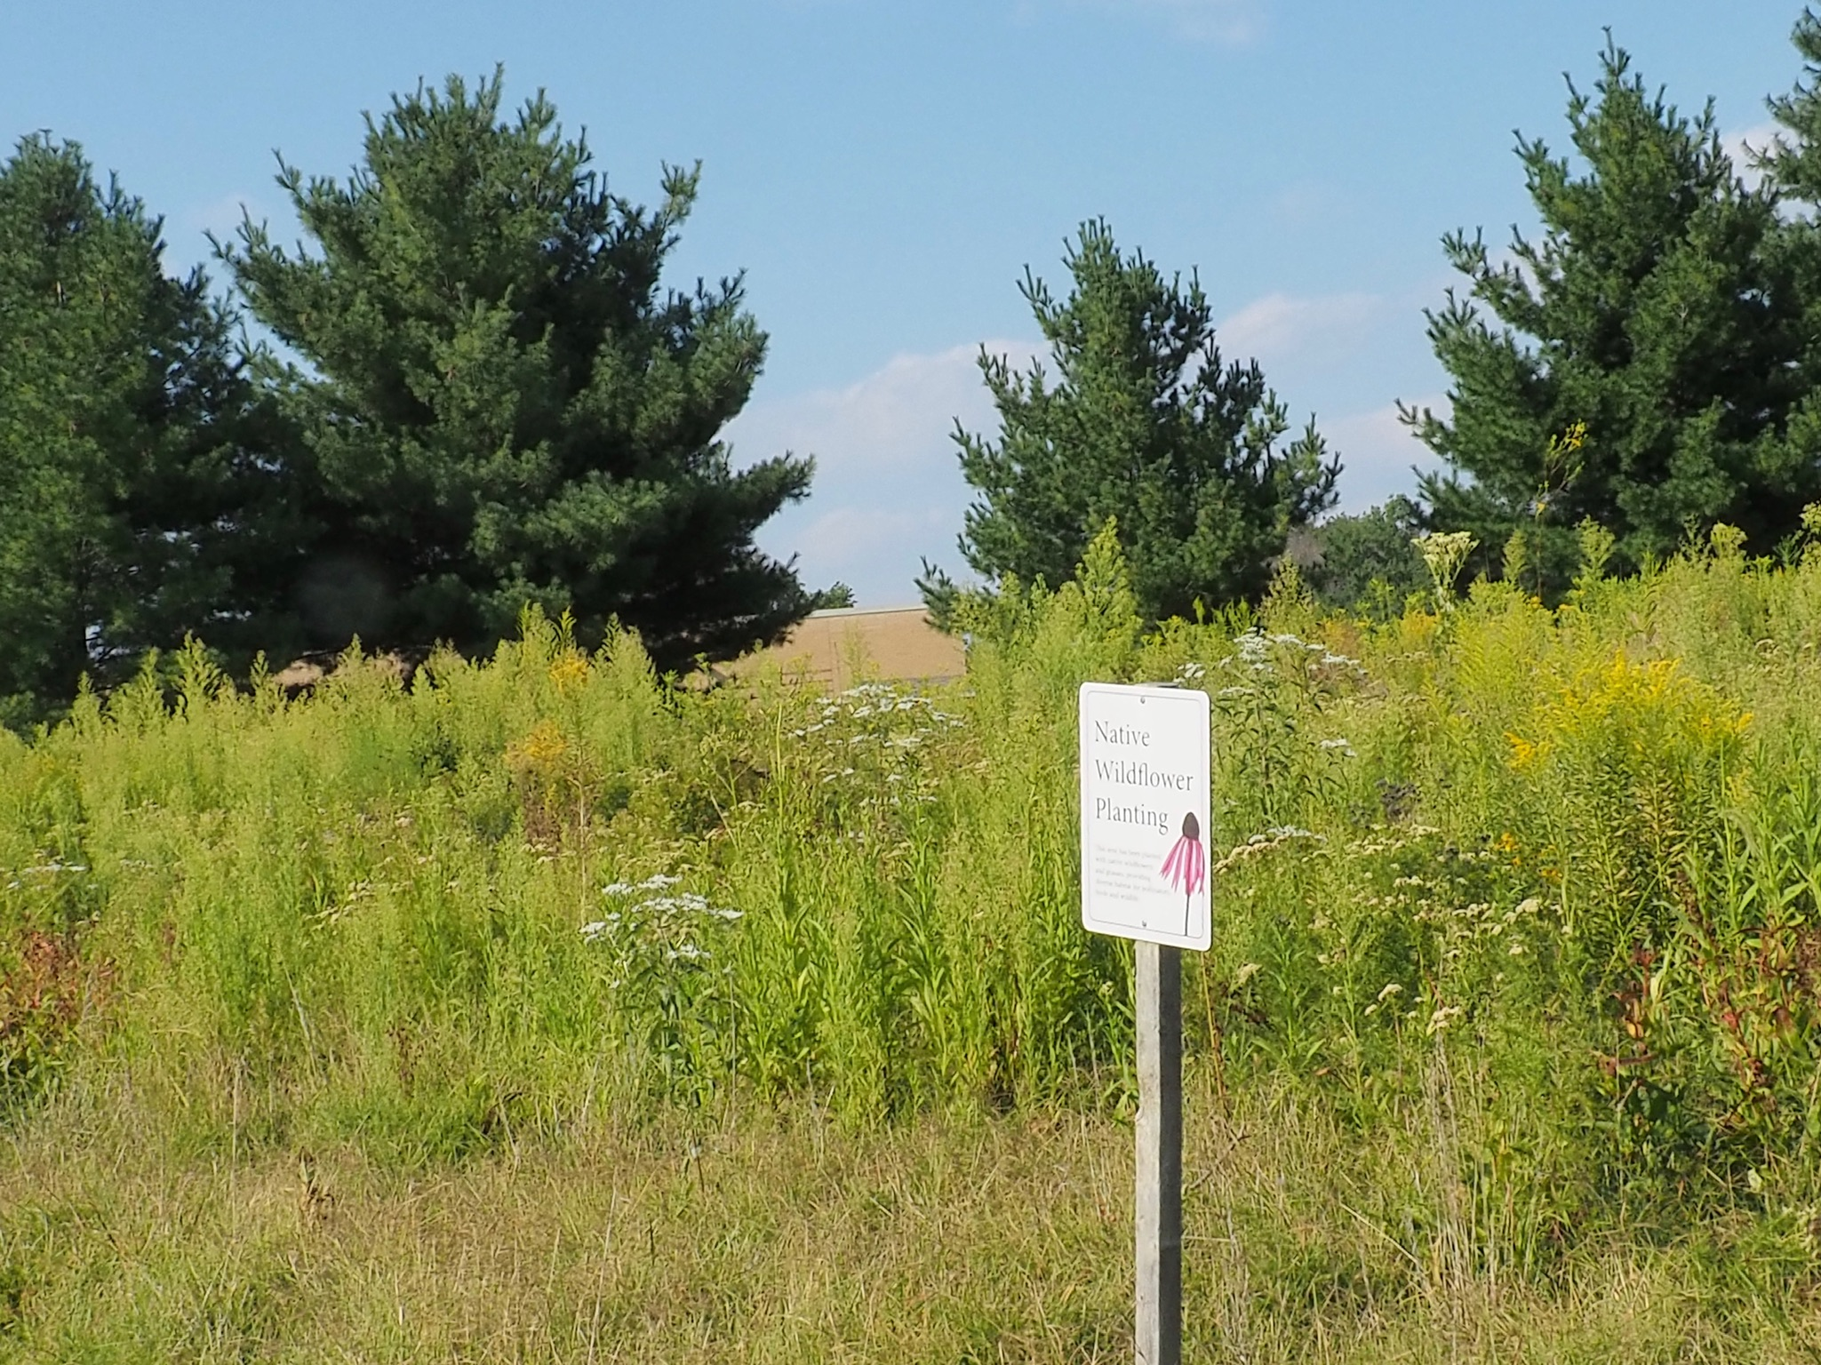
CUF’s Prairie
Habitat for wildlife
Refuge for pollinators of all types
Beautiful landscape
Putting environmental stewardship into action

